Slide 1

Artificial Neural Networks
Payam Barnaghi
Department of Brain Sciences &
School of Convergence Science in Human and Artificial Intelligence
Imperial College London
January 2025
Notes:
1

Slide 2
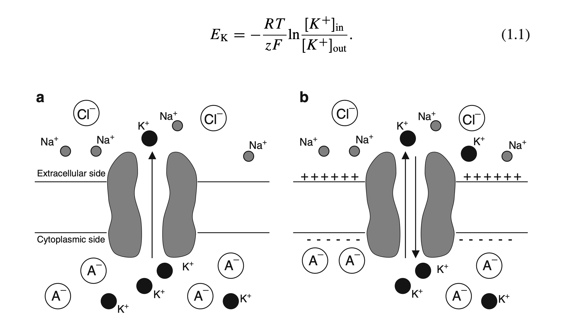
Hodgkin-Huxley neuron model
This is a computational model of a biological neuron; in contrast, in ML, we are interested in modelling an artificial neuron that can help us to solve (machine) learning and decision-making problems.
Image from: http://www.math.pitt.edu/~bdoiron/assets/ermentrout-and-terman-ch-1.pdf
Notes:
Here, EK is the KC Nernst potential, R is the gas constant, T is the absolute temperature in kelvin, z is the valence of KC, F is Faraday’s constant, and ŒKCout and ŒKCin are the concentrations of KC ions outside and inside the cell. A similar formula holds for the NaC and Cl Nernst potentials.

Slide 3

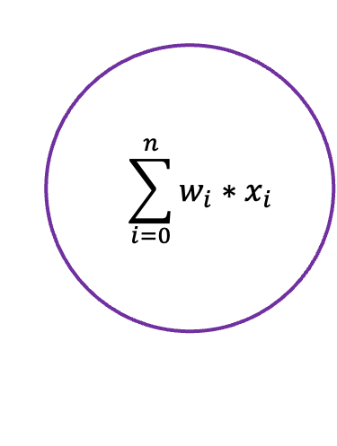





Artificial Neuron
$$x_{1}$$
$$w_{1}$$
$$=\sum_{i=0}^{n}{w_{i}{∗x}_{i}}$$
$$w_{2}$$
$$x_{2}$$
y
$$w_{3}$$
$$x_{3}$$

Slide 4
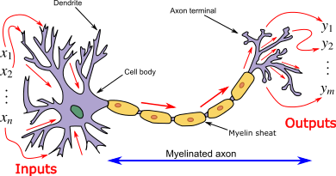
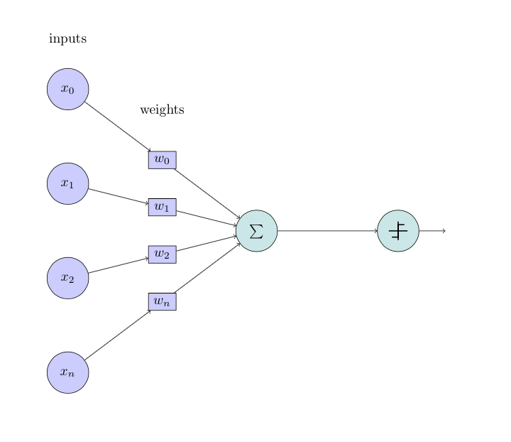
Artificial neuron vs biological neuron

Slide 5

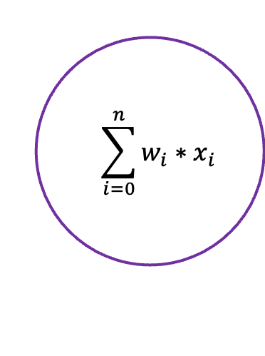





Artificial Neuron with Bias
b
$$x_{1}$$
$$w_{1}$$
$$=\sum_{i=0}^{n}{w_{i}{∗x}_{i}}$$
$$w_{2}$$
$$x_{2}$$
y
$$w_{3}$$
$$x_{3}$$

Slide 6
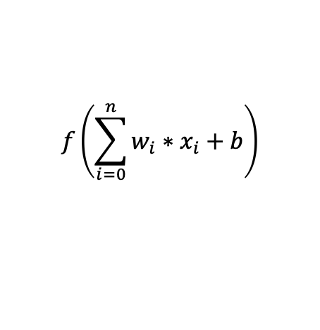
Artificial neurons and the effect of bias
b
$$x_{1}$$
$$w_{1}$$
$$w_{2}$$
$$f\left(\sum_{i=0}^{n}{w_{i}{∗x}_{i}}+b\right)$$
$$x_{2}$$
y
$$w_{3}$$
$$x_{3}$$

Slide 7
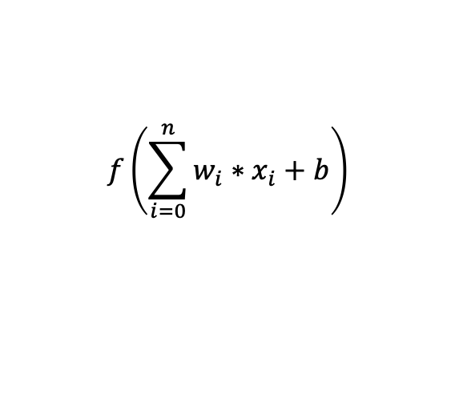
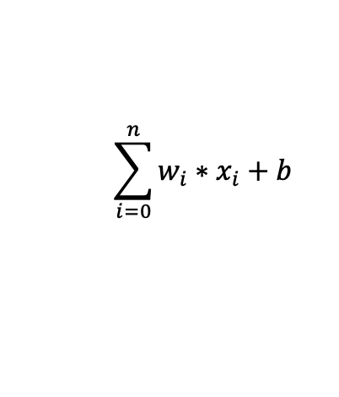
NN with an Activation Function
b
$$x_{1}$$
$$w_{1}$$
$$w_{2}$$
$$\sum_{i=0}^{n}{w_{i}{∗x}_{i}}+b$$
$$x_{2}$$
y
$$w_{3}$$
$$x_{3}$$
$$f\left(\sum_{i=0}^{n}{w_{i}{∗x}_{i}}+b\right)$$

Slide 8
Limitations of linear models
Linearity implies the weaker assumption of monotonicity, i.e., that any increase in our feature must either always cause an increase in our model’s output (if the corresponding weight is positive) or always cause a decrease in our model’s output (if the corresponding weight is negative).
However, this is not always true or helpful in real-world applications. For individuals with a body temperature above 37C (98.6F), higher temperatures indicate greater risk. However, this risk does not linearly increase when, for example, the temperature drops below 37 or goes above 38.5.

Slide 9
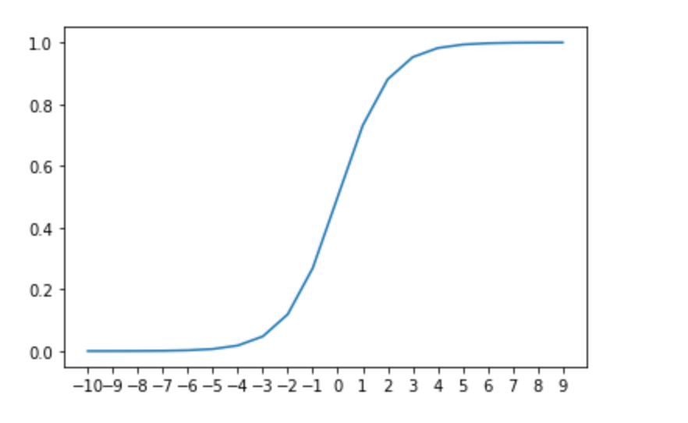
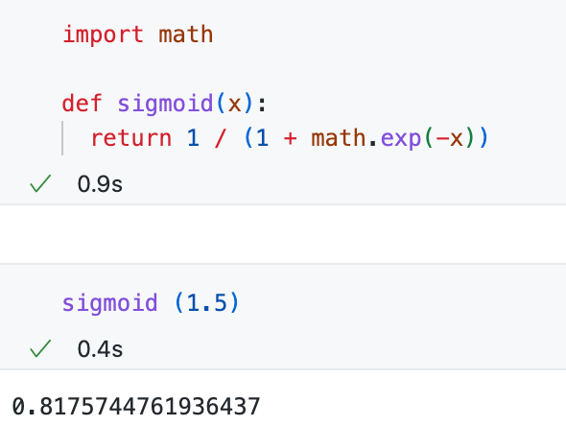
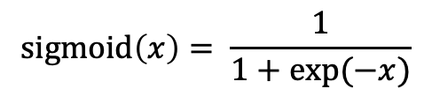
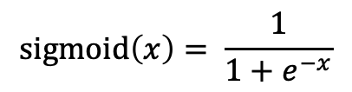
Sigmoid function
$$sigmoid\left(x\right)= \frac{1}{1+e^{−x}}$$
$$sigmoid\left(x\right)= \frac{1}{1+exp⁡(−x)}$$

Slide 10

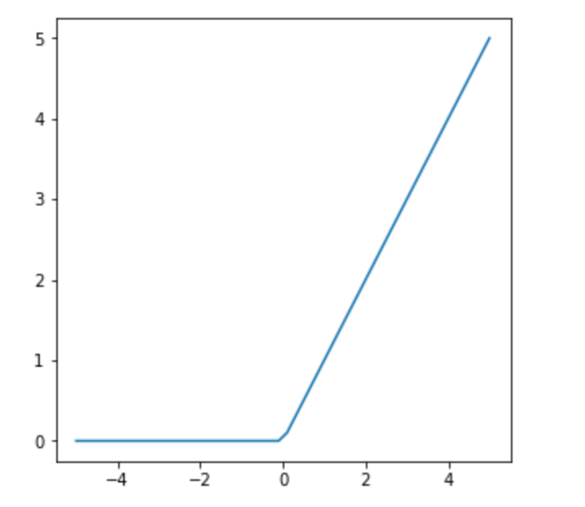
Rectified Linear Units (ReLU)

Slide 11
ReLU
The half rectifying nonlinearity simulates some of the properties of biological neurons:
For some inputs, biological neurons are completely inactive (sparse activation).
For some inputs, a biological neuron’s output is proportional to its inputs.
Most of the time, biological neurons operate in a way that they are inactive (i.e., they have sparse activation).

Slide 12
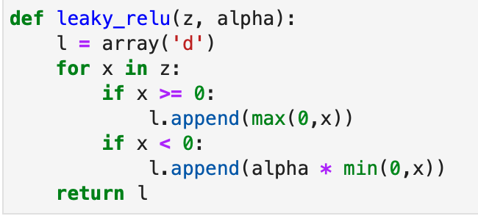
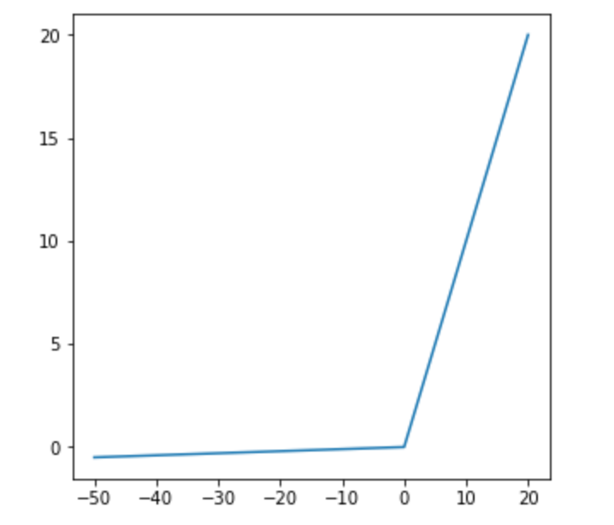
Leaky ReLU

Slide 13
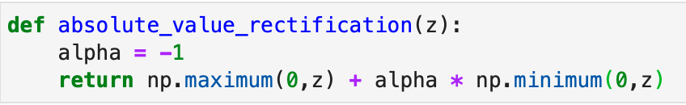
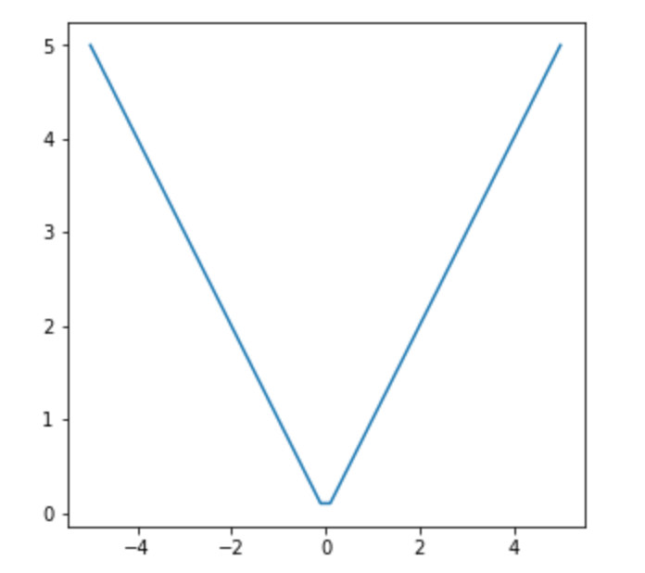
Absolute Value Rectification

Slide 14
Nonlinearity in machine problems
In the past lectures, we have seen that the decision space and feature representation in most machine learning problems is not linear.
So, the question is how to add nonlinearity to the neural network models.

Slide 15
Hidden layers
We can overcome the limitations of linear models by also incorporating one or more hidden layers (with activation functions).
The easiest way to do this is to stack several fully connected layers on top of each other.
Each layer feeds into the layer above it until the model generates outputs.
This architecture is commonly called a Multilayer Perceptron, often abbreviated as MLP.

Slide 16
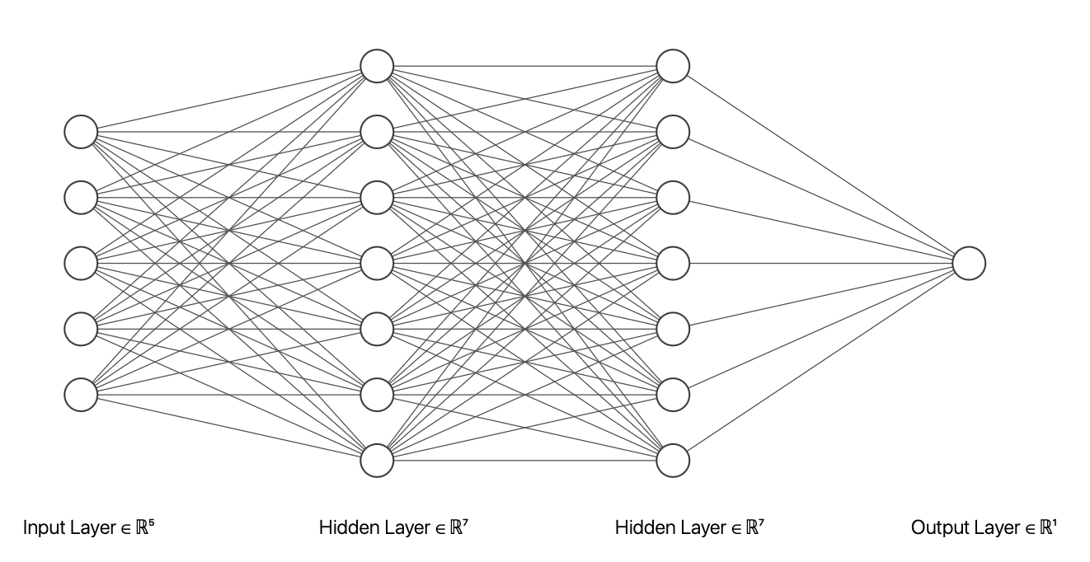
Multilayer perceptron architecture
The figure is drawn using: https://alexlenail.me/NN-SVG/

Slide 17
MLP architecture
We can think of the first L−1 layers as our representation and the final layer as our linear predictor.

Slide 18
Layers in a neural network
Input layer
Hidden layers
Output layer
The number of hidden layers determines the depth of the network. The term “deep learning” originates from this terminology.
The width of the network is determined by the number of nodes (dimensionality) in the hidden layer(s).

Slide 19
How neuroscience has inspired this model
The idea of using many layers of connected neurons and networks (here are very structurally connected).
The concept of using an activation function.
There are several more advanced architectures that mimic other concepts from neuroscience, such as memory-based models (e.g. LSTM) and attention-based models (e.g. Transformers).

Slide 20
Forward propagation
Forward propagation (or forward pass) refers to the calculation and storage of intermediate variables (including outputs) for a neural network in order from the input layer to the output layer.
We now work step-by-step through the mechanics of a neural network with one hidden layer.
For the sake of simplicity, let’s assume that our hidden layer does not include a bias term.

Slide 21
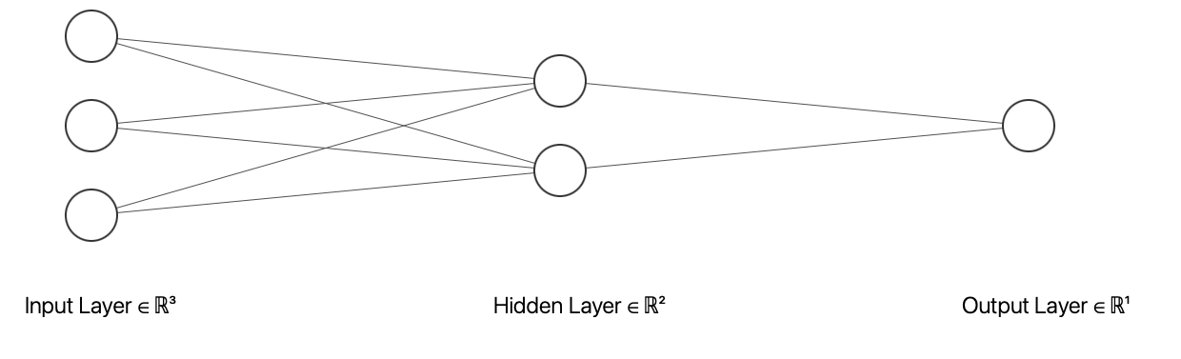

Forward propagation – step 1

Slide 22

Forward propagation – step 2

Slide 23

Forward propagation – step 3

Slide 24
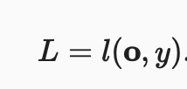
Forward propagation – Loss function (l)

Slide 25
Back propagation
Backpropagation refers to the method of calculating the gradient of neural network parameters.
The method traverses the network in reverse order, from the output to the input layer, according to the chain rule from calculus.
The algorithm stores any intermediate variables (partial derivatives) required while calculating the gradient with respect to some parameters.

Slide 26
Training a neural network - 1
Often, we start with random weight initialisation.
And then go through multiple iterations applying all the training samples (forward propagation).
Then, calculate the error/loss based on a loss function.
After that, we use the error/loss value to update the weights.
We repeat this training iteration several times; in NN terms, each iteration of trying all the training samples in one round is called an “epoch”.

Slide 27
Random initialisation**
If you are interested in the effect of initialisation parameters, see:
https://stackoverflow.com/questions/49433936/how-do-i-initialize-weights-in-pytorch
https://pytorch.org/docs/stable/nn.init.html
Understanding the difficulty of training deep feedforward neural networks, Glorot, X. & Bengio, Y. (2010) https://proceedings.mlr.press/v9/glorot10a/glorot10a.pdf

Slide 28
Training neural networks
When training neural networks, forward and backward propagation depend on each other.
In forward propagation, we traverse the computational graph in the direction of dependencies and compute all the variables on its path.
These are then used for backpropagation, where the compute order on the graph is reversed.

Slide 29
Training a neural network - 1
Now, the question is how to update the weights to optimise the model to obtain less error/loss.
We need a way to calculate the intermediary values for backpropagation and updating the weights.
We need a hyperparameter to control the rate of change. This is often done by a hyperparameter called “learning rate”.

Slide 30
Forward propagation – Loss function (l)

Slide 31
Gradient in neural network
Or more precisely gradient of neural network parameters.
In backpropagation, we need to calculate the partial derivates of variables with respect to some parameters.

Slide 32
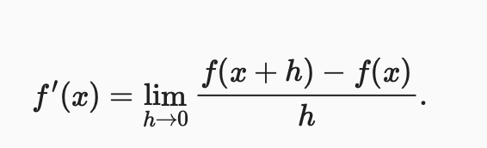
Derivatives and Differentiation*
A derivative is the rate of change in a function with respect to changes in its arguments.
Derivatives can tell us how rapidly a loss function would increase or decrease if we increase or decrease each parameter by an infinitesimally small amount.

Slide 33
** Example: Calculate the derivative of f(x) = x²

Slide 34
Example - 1

Slide 35
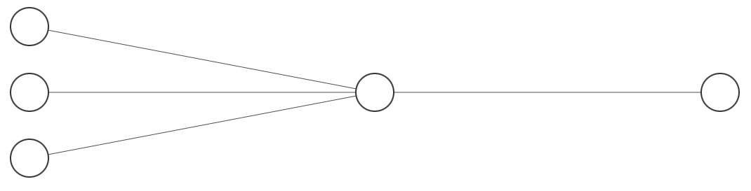
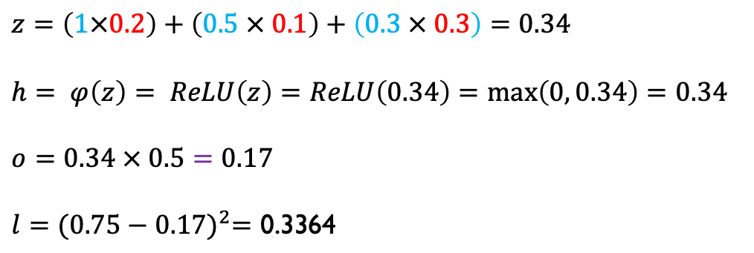
Example - 2
input
1
0.2
y = 0.75 (output/target)
0.1
0.5
0.5
0.3
loss = (y – o)²
0.3
$$z=\left(1×0.2\right)+\left(0.5 × 0.1\right)+\left(0.3 × 0.3\right)=0.34$$
$$h= φ\left(z\right)= ReLU\left(z\right)=ReLU\left(0.34\right)=\max\left(0, 0.34\right)=0.34$$
$$o=0.34 × 0.5=0.17$$
$$l={(0.75−0.17)}^{2}=\text{0.3364}$$

Slide 36
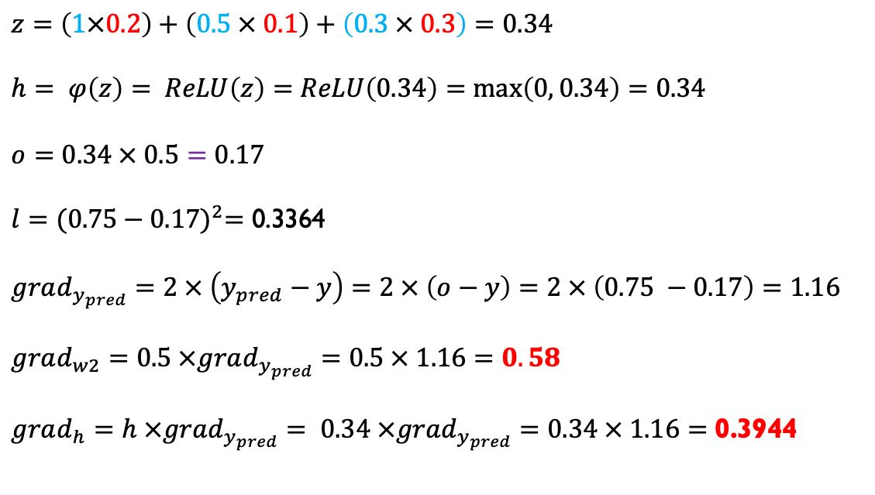



Example – backpropagation
$$o$$
input
$$z$$
$$h$$
$$l$$
1
0.2
y = 0.75 (output)
0.1
0.5
0.5
0.3
loss = (y – o)²
0.3
$$grad_{y_{pred}}$$
$$z=\left(1×0.2\right)+\left(0.5 × 0.1\right)+\left(0.3 × 0.3\right)=0.34$$
$$h= φ\left(z\right)= ReLU\left(z\right)=ReLU\left(0.34\right)=\max\left(0, 0.34\right)=0.34$$
$$o=0.34 × 0.5=0.17$$
$$l={(0.75−0.17)}^{2}=\text{0.3364}$$
$$grad_{y_{pred}}=2 × \left(y_{pred}−y\right)=2 × \left(o−y\right)=2 × \left(0.75 −0.17\right)=1.16$$
$grad_{w2}=0.5 ×grad_{y_{pred}}=0.5 × 1.16=0.58$
$$grad_{h}=h ×grad_{y_{pred}}= 0.34 ×grad_{y_{pred}}=0.34 × 1.16=\text{0.3944}$$

Slide 37
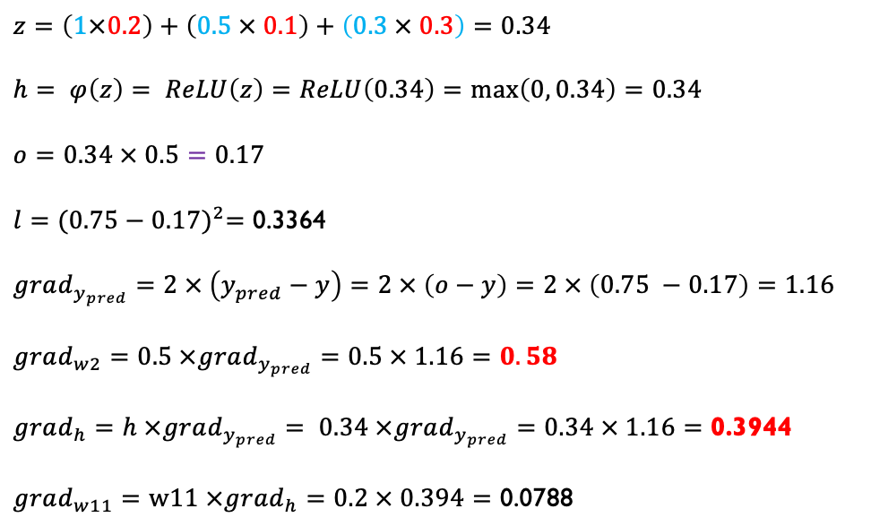
Example – backpropagation
$$o$$
input
$$z$$
$$h$$
$$l$$
1
0.2
y = 0.75 (output)
0.1
0.5
0.5
0.3
loss = (y – o)²
0.3
$$grad_{y_{pred}}$$
$$z=\left(1×0.2\right)+\left(0.5 × 0.1\right)+\left(0.3 × 0.3\right)=0.34$$
$$h= φ\left(z\right)= ReLU\left(z\right)=ReLU\left(0.34\right)=\max\left(0, 0.34\right)=0.34$$
$$o=0.34 × 0.5=0.17$$
$$l={(0.75−0.17)}^{2}=\text{0.3364}$$
$$grad_{y_{pred}}=2 × \left(y_{pred}−y\right)=2 × \left(o−y\right)=2 × \left(0.75 −0.17\right)=1.16$$
$grad_{w2}=0.5 ×grad_{y_{pred}}=0.5 × 1.16=0.58$
$$grad_{h}=h ×grad_{y_{pred}}= 0.34 ×grad_{y_{pred}}=0.34 × 1.16=\text{0.3944}$$
$$grad_{w11}=w11 ×grad_{h}=0.2 × 0.394=\text{0.0788}$$

Slide 38
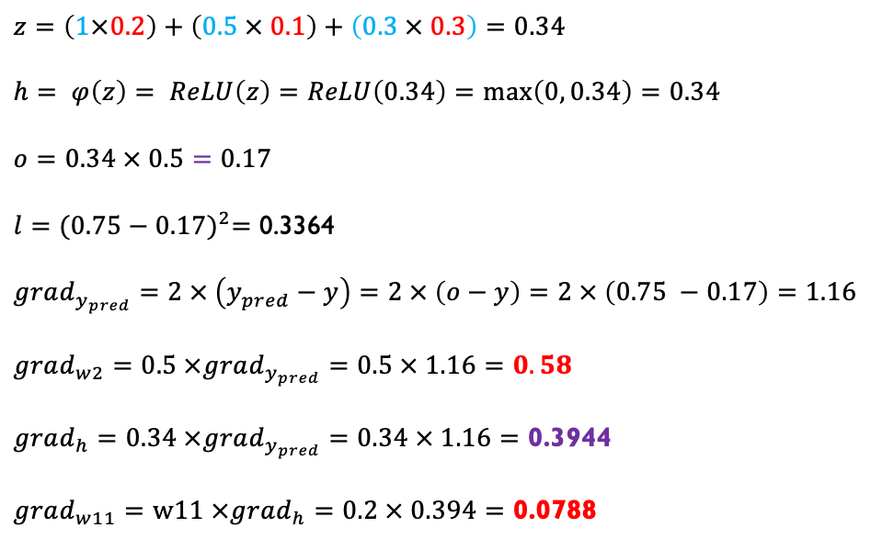
Example – backpropagation
$$o$$
input
$$z$$
$$h$$
$$l$$
1
0.2
y = 0.75 (output)
0.1
0.5
0.5
0.3
loss = (y – o)²
0.3
$$grad_{y_{pred}}$$
$$z=\left(1×0.2\right)+\left(0.5 × 0.1\right)+\left(0.3 × 0.3\right)=0.34$$
$$h= φ\left(z\right)= ReLU\left(z\right)=ReLU\left(0.34\right)=\max\left(0, 0.34\right)=0.34$$
$$o=0.34 × 0.5=0.17$$
$$l={(0.75−0.17)}^{2}=\text{0.3364}$$
$$grad_{y_{pred}}=2 × \left(y_{pred}−y\right)=2 × \left(o−y\right)=2 × \left(0.75 −0.17\right)=1.16$$
$grad_{w2}=0.5 ×grad_{y_{pred}}=0.5 × 1.16=0.58$
$$grad_{h}=0.34 ×grad_{y_{pred}}=0.34 × 1.16=\text{0.3944}$$
$$grad_{w11}=w11 ×grad_{h}=0.2 × 0.394=\text{0.0788}$$
w1 = w1 - grad_w1;
w2 = w2 - grad_w2;

Slide 39
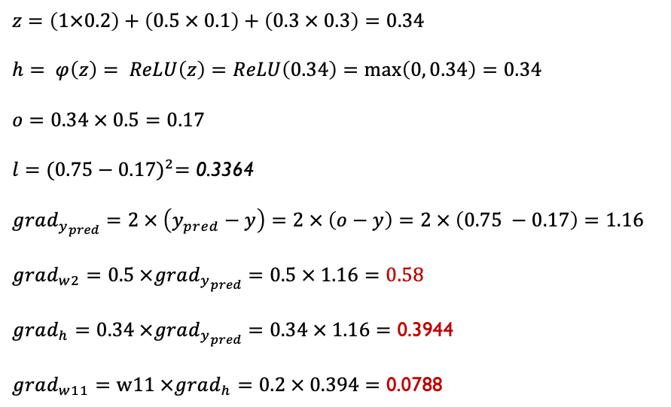
Example – backpropagation
$$o$$
input
$$z$$
$$h$$
$$l$$
1
0.2
y = 0.75 (output)
0.1
0.5
0.5
0.3
loss = (y – o)2
0.3
$$grad_{y_{pred}}$$
$$z=\left(1×0.2\right)+\left(0.5 × 0.1\right)+\left(0.3 × 0.3\right)=0.34$$
$$h= φ\left(z\right)= ReLU\left(z\right)=ReLU\left(0.34\right)=\max\left(0, 0.34\right)=0.34$$
$$o=0.34 × 0.5=0.17$$
$$l={(0.75−0.17)}^{2}=\text{0.3364}$$
$$grad_{y_{pred}}=2 × \left(y_{pred}−y\right)=2 × \left(o−y\right)=2 × \left(0.75 −0.17\right)=1.16$$
$grad_{w2}=0.5 ×grad_{y_{pred}}=0.5 × 1.16=0.58$
$$grad_{h}=0.34 ×grad_{y_{pred}}=0.34 × 1.16=\text{0.3944}$$
$$grad_{w11}=w11 ×grad_{h}=0.2 × 0.394=\text{0.0788}$$
w₁₁ = w₁₁ – (learning_rate * grad_w₁₁)
w₁₂ = w₁₂ – (learning_rate * grad_w₁₂)
w₁₃ = w₁₃ – (learning_rate * grad_w₁₃)
w₂ = w₂ – (learning_rate * grad_w2)

Slide 40
Learning rate
Learning rate is a hyperparameter that controls the change of weights in neural networks with respect to the gradient.
The learning rate scales the magnitude of change for the weights.
For example:
w1 = w1 – (learning_rate * grad_w1)
w2 = w2 – (learning_rate * grad_w2)

Slide 41
How to choose a learning rate
There are various ways to choose and optimise the learning rate.
A simple approach is to start with a relatively large value (e.g. 0.01 or 0.1) and then (exponentially) reduce it over iterations.
With dynamic learning rates, if the learning decreases too rapidly, it will affect the network convergence (i.e. finding an optimal solution).
If (a large) learning rate changes too slowly, the network may fail to converge to a good enough solution since noise (noise in samples that causes noisy gradients) could keep on driving the network away from an optimal solution.

Slide 42
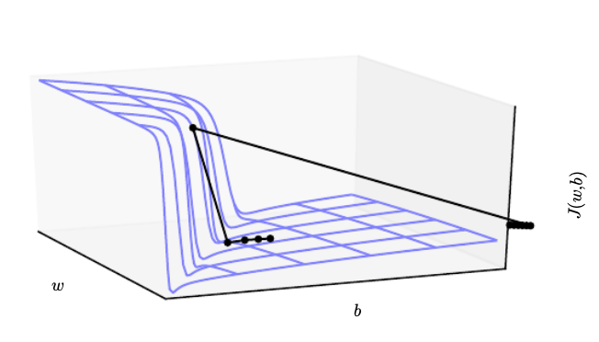
Exploding and vanishing gradients*
- The objective function for highly nonlinear deep neural networks or recurrent neural networks often contains sharp nonlinearities in parameter space resulting from the multiplication of several parameters.
- These nonlinearities give rise to very
high derivatives in some places.
- When the parameters get close to such a cliff region, a gradient descent update can catapult the parameters very far, possibly losing most of the optimisation work that has been done.
Source: Adapted from Goodfellow et al., Deep Learning, MIT Press, https://www.deeplearningbook.org/contents/optimization.html
Original figure from (Pascanu et al., 2013)

Slide 43
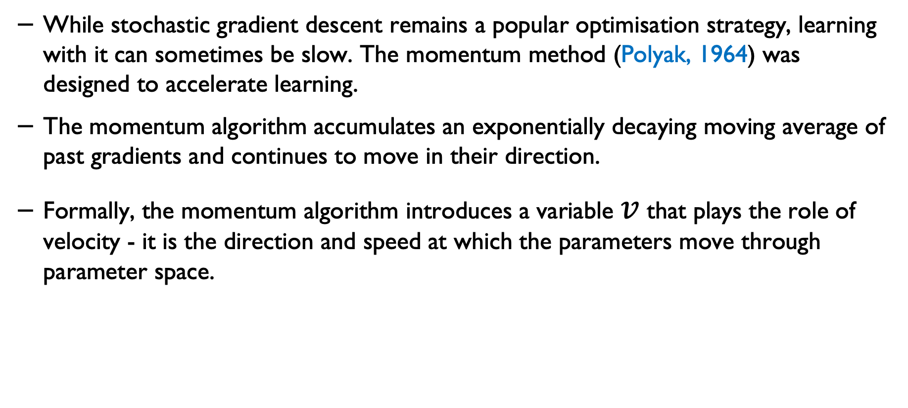
Momentum
While stochastic gradient descent remains a popular optimisation strategy, learning with it can sometimes be slow. The momentum method (Polyak, 1964) was designed to accelerate learning.
The momentum algorithm accumulates an exponentially decaying moving average of past gradients and continues to move in their direction.
Formally, the momentum algorithm introduces a variable $v$ that plays the role of velocity - it is the direction and speed at which the parameters move through parameter space.
Goodfellow et al., Deep Learning, MIT Press, https://www.deeplearningbook.org/contents/optimization.html

Slide 44
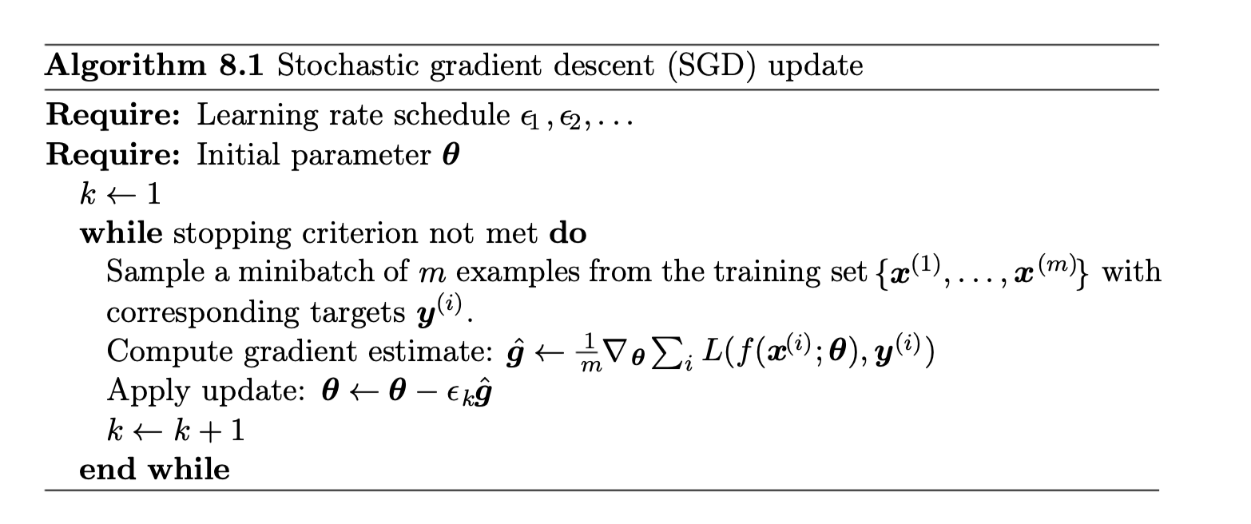
SGD
Source: Goodfellow et al., Deep Learning, MIT Press, https://www.deeplearningbook.org/contents/optimization.html

Slide 45
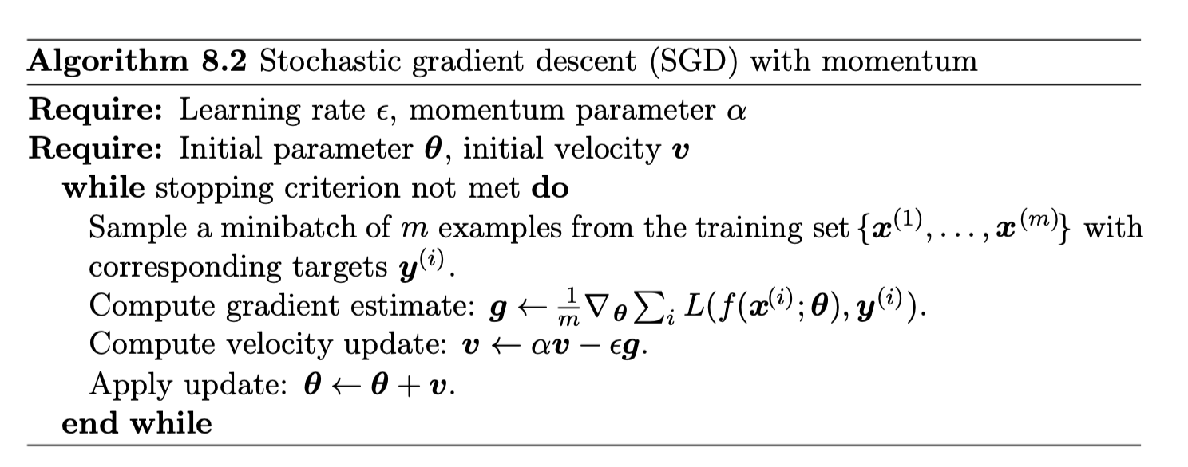
SGD with momentum
Source: Goodfellow et al., deep Learning, https://www.deeplearningbook.org/contents/optimization.html

Slide 46
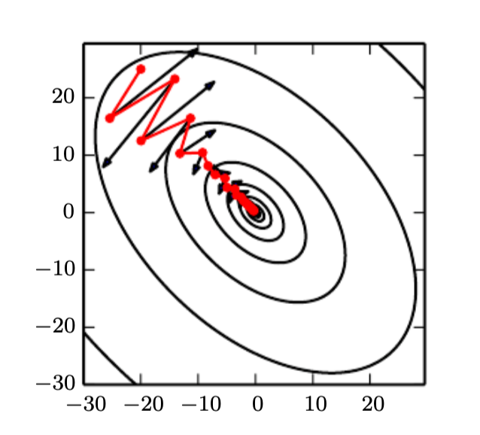


Momentum*
If $α=0,$ the momentum acts like a normal gradient descent:
An example with a non-zero $α$

Slide 47
Algorithms with adaptive learning rate
The AdaGrad algorithm adapts the learning rates of all model parameters by scaling them inversely proportional to the square root of the sum of all the historical squared values of the gradient (Duchi et al.,2011).
Source: Adapted from Goodfellow et al., Deep Learning, MIT Press, https://www.deeplearningbook.org/contents/optimization.html

Slide 48
RMSProp
The RMSProp algorithm (Hinton, 2012) modiﬁes AdaGrad to perform better in the nonconvex setting by changing the gradient accumulation into an exponentially weighted moving average.
AdaGrad shrinks the learning rate according to the entire history of the squared gradient and may have made the learning rate too small before arriving at such a convex structure.
RMSProp uses an exponentially decaying average to discard history from the extreme past so that it can converge rapidly.
It has a decay rate parameter.
Source: Adapted from Goodfellow et al., Deep Learning, MIT Press, https://www.deeplearningbook.org/contents/optimization.html

Slide 49
Adam
Adam (Kingma and Ba, 2014) is another adaptive learning rate optimisation algorithm.
The name “Adam” derives from the phrase “adaptive moments.”
In Adam, momentum is incorporated directly as an estimate of the ﬁrst-order moment (with exponential weighting) of the gradient.
The most straightforward way to add momentum to RMSProp is to apply momentum to the rescaled gradients.
Adam includes bias corrections to the estimates of both the ﬁrst-order moments (the momentum term) and the (uncentered) second-order moments to account for their initialisation at the origin.
Source: Adapted from Goodfellow et al., Deep Learning, MIT Press, https://www.deeplearningbook.org/contents/optimization.html

Slide 50
Adam*
Adam uses exponential weighted moving averages (also known as leaky averaging) to obtain an estimate of both the momentum and the second moment of the gradient.

Slide 51
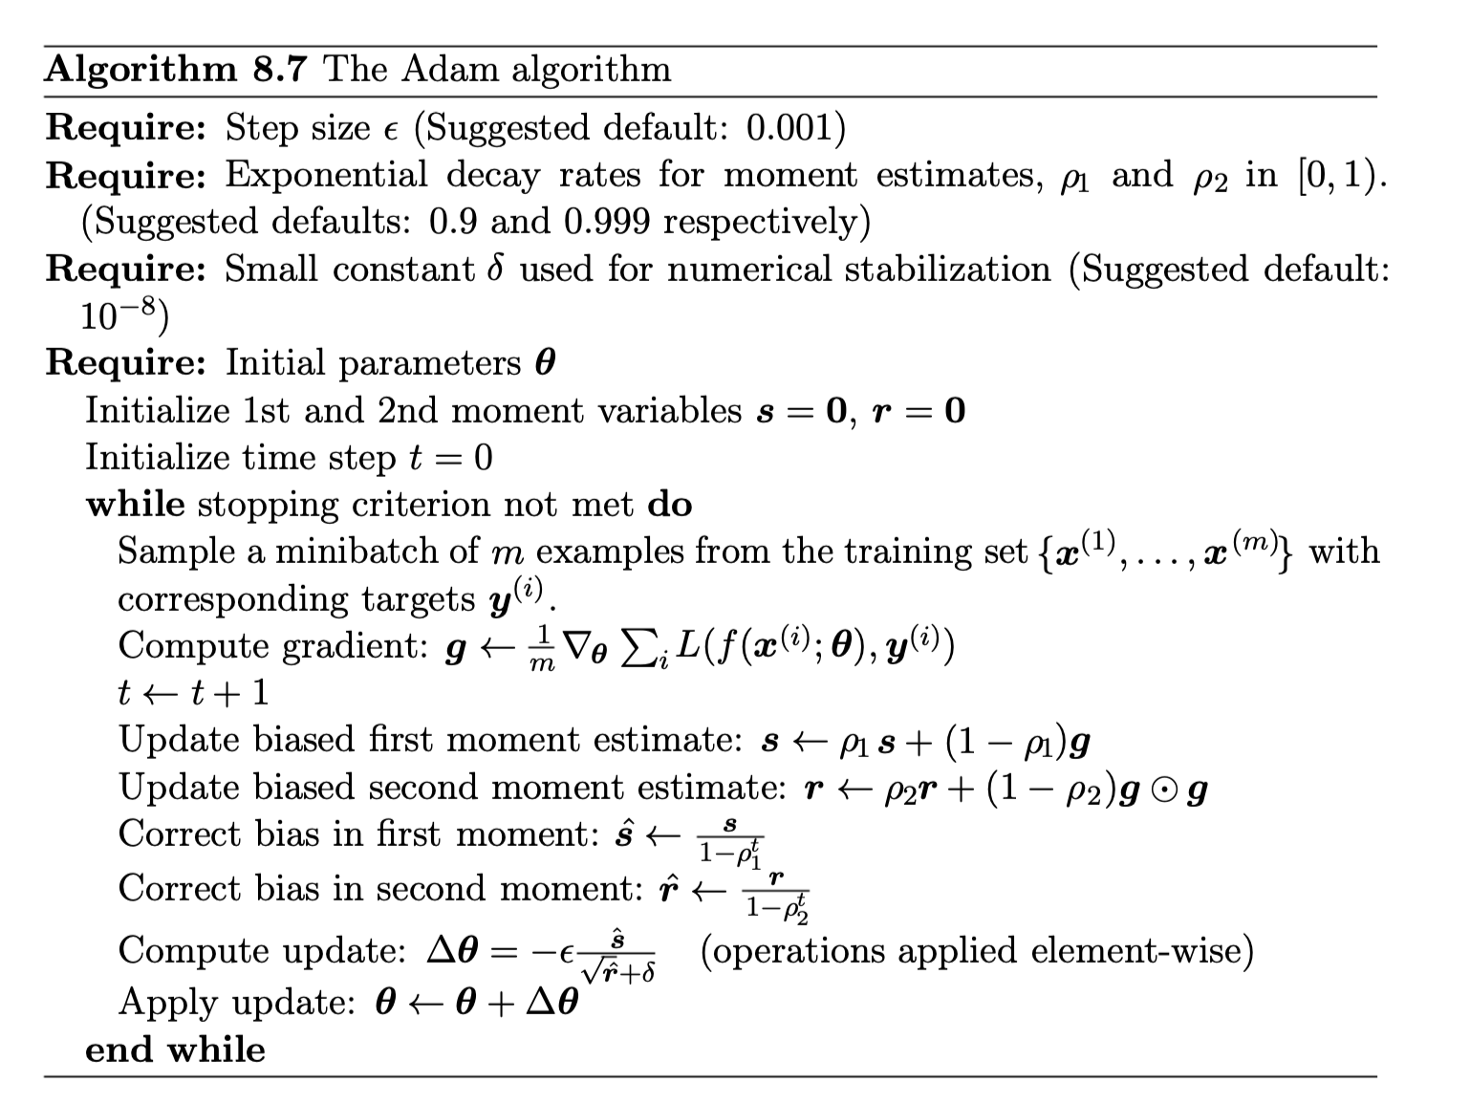
Adam**
Source: Adapted from Goodfellow et al., Deep Learning, MIT Press, https://www.deeplearningbook.org/contents/optimization.html

Slide 52
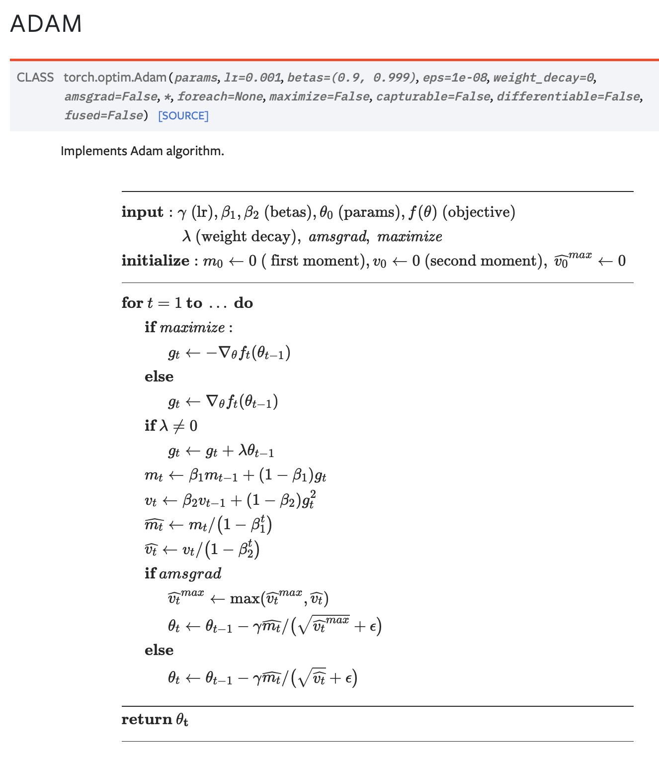
Adam**
Same as the previous slide with just different notations to show the variables and parameters.
See: https://pytorch.org/docs/stable/generated/torch.optim.Adam.html

Slide 53
How to choose the number of hidden layers
This depends on the complexity of the data and the decision boundaries (i.e. how separable the data is).
This could also depend on the number of features/dimensions.
A very basic recommendation is that 2 to 3 hidden layers be used for less complex problems, and 3 to 5 hidden layers be used for more complex problems.
Several deep learning architectures use more layers. The more layers you add, the more hyperparameters you need to train and optimise. This complexity would impact your network's convergence (and overfitting).
The number of neurons in hidden layers is also important (width) of the network.

Slide 54
Dropouts
Dropout is a regularisation technique to reduce the risk of overfitting in neural networks.
In neural networks, it refers to temporarily dropping input and hidden layer nodes.
This creates a new temporary architecture by randomly dropping a percentage of the nodes during the training process.

Slide 55
Dropout – philosophy
A key idea behind applying dropout is that training a neural network by adding a stochastic behaviour and making predictions, and averaging over multiple stochastic decisions simulates a from of bagging with parameter sharing.
In Bagging (i.e., bootstrap aggregation) several models are combined to reduce the generalisation error.
The idea of Bagging is to train multiple models separately and then use all the models to vote on the output for the test example.

Slide 56
Dropouts – practical notes
When the training sample is very small, the dropout method is not very effective.
When additional unlabeled samples are available, unsupervised feature learning can improve the performance better than dropout.

Slide 57
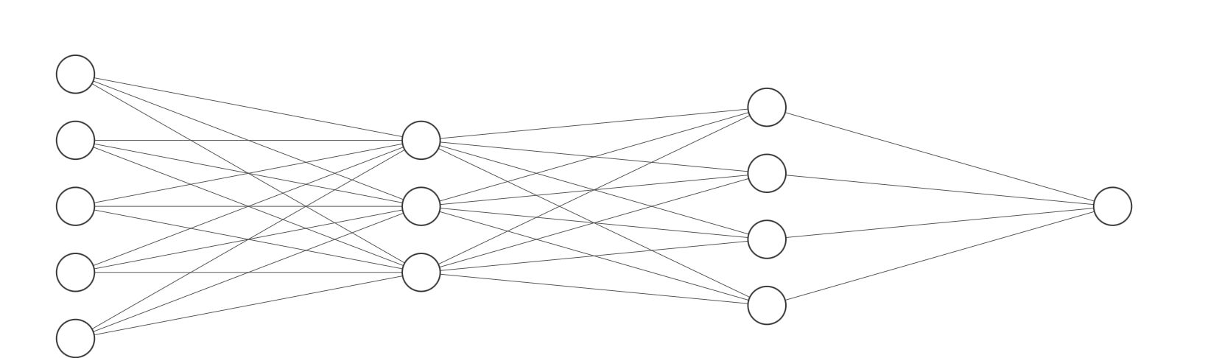
Example - 1

Slide 58
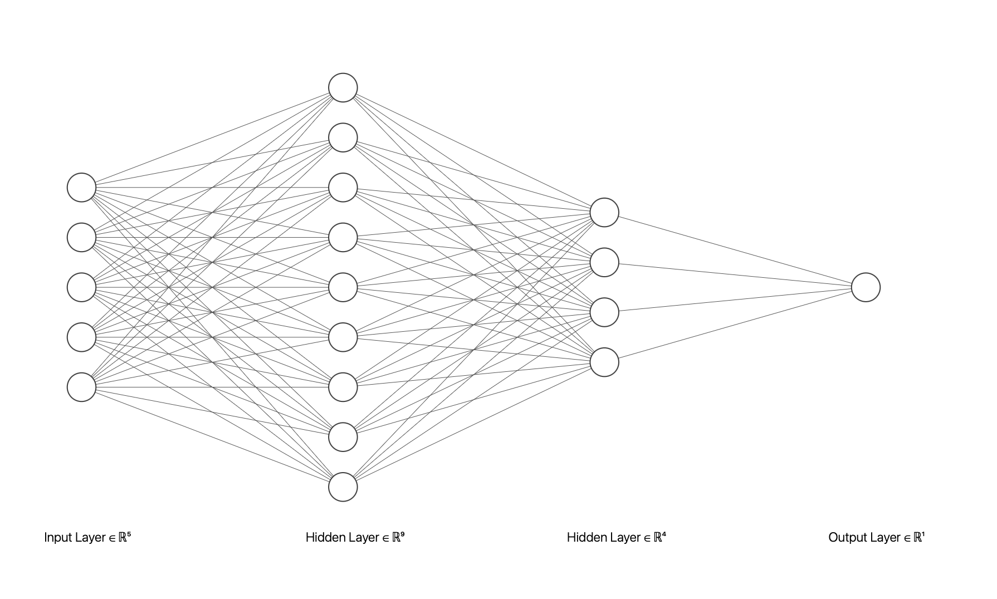
Example -2

Slide 59
Review questions

Slide 60
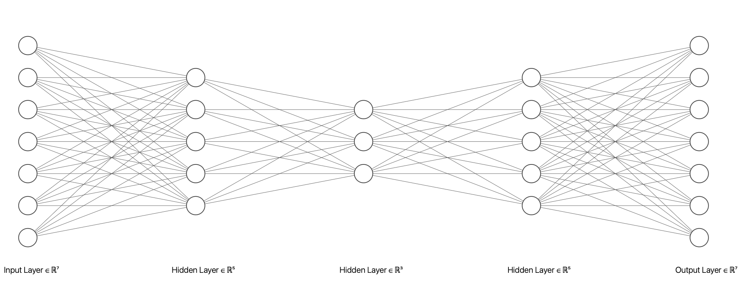
Q1
What could be the purpose of a NN architecture like this?

Slide 61
Q2
Which of these will not improve the convergence of a neural network model?
Adaptive learning rate
Data normalisation
Using an optimiser method
Initialising all the weights to zero (zero initialisation)

Slide 62
Acknowledgments
Some of the slides are adapted from Dive into Deep Learning by Aston Zhang et al., https://d2l.ai/index.html

Slide 63
If you have any questions
Please feel free to arrange a meeting or email (p.barnaghi@imperial.ac.uk).
My office: 928, Sir Michael Uren Research Hub, White City Campus.

Slide 64
Further reading

Slide 65
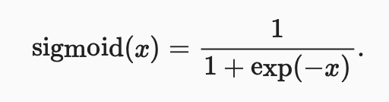
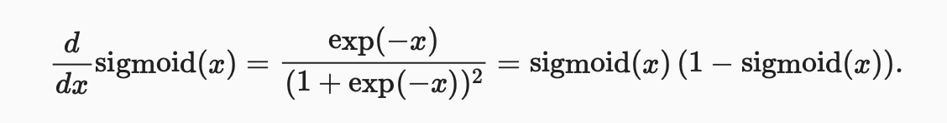
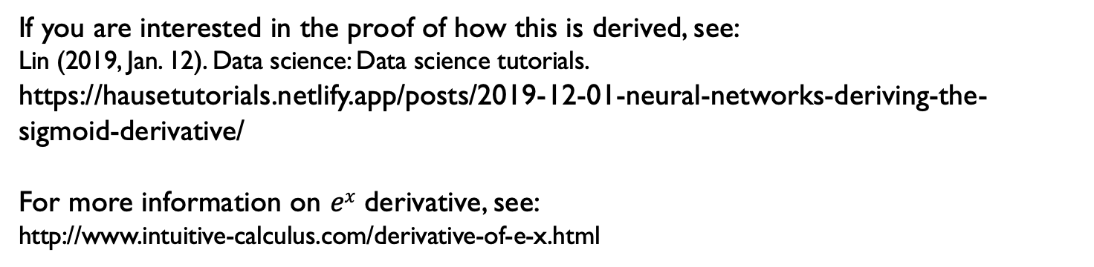
Derivative of Sigmoid function
If you are interested in the proof of how this is derived, see:
Lin (2019, Jan. 12). Data science: Data science tutorials.
https://hausetutorials.netlify.app/posts/2019-12-01-neural-networks-deriving-the-sigmoid-derivative/
For more information on $ex$ derivative, see:
http://www.intuitive-calculus.com/derivative-of-e-x.html
Source for the formula: Dive into Deep Learning by Aston Zhang et al., https://d2l.ai/index.html

Slide 66
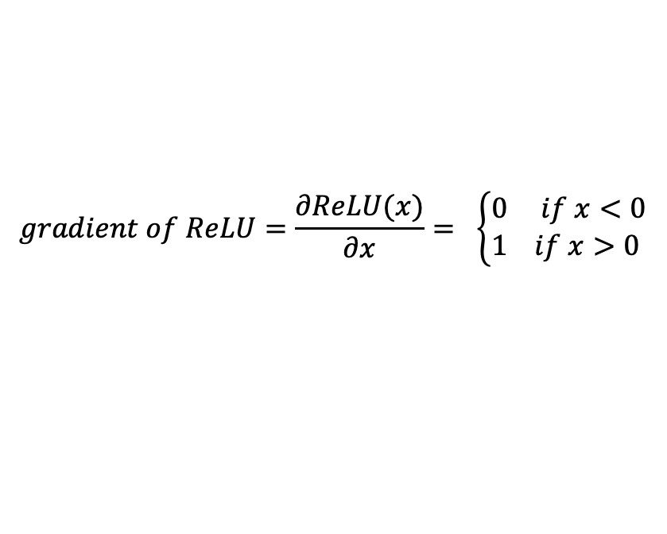
Gradient of ReLU
$$gradient of ReLU=\frac{∂ReLU(x)}{∂x}= \left\{\begin{aligned}0 if x<0 \\ 1 if x>0 \end{aligned}\right.$$
For other gradients and an excellent summary, you can refer to the blog post by by Andrew Wood at:
https://aew61.github.io/blog/artificial_neural_networks/1_background/1.b_activation_functions_and_derivatives.html
Source for the formula: Dive into Deep Learning by Aston Zhang et al., https://d2l.ai/index.html

Slide 67
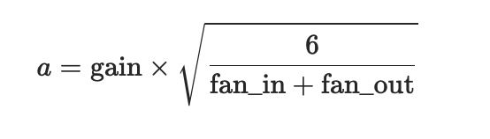
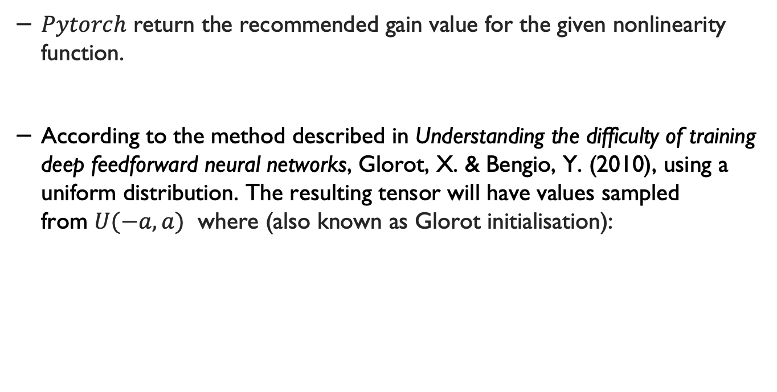
Random initialisation**
$Pytorch$ return the recommended gain value for the given nonlinearity function.
According to the method described in Understanding the difficulty of training deep feedforward neural networks, Glorot, X. & Bengio, Y. (2010), using a uniform distribution. The resulting tensor will have values sampled from $U(−a,a)$ where (also known as Glorot initialisation):
f$an_in and fan_out$:
https://stackoverflow.com/questions/42670274/how-to-calculate-fan-in-and-fan-out-in-xavier-initialization-for-neural-networks
Source: https://pytorch.org/docs/stable/nn.init.html

Slide 68

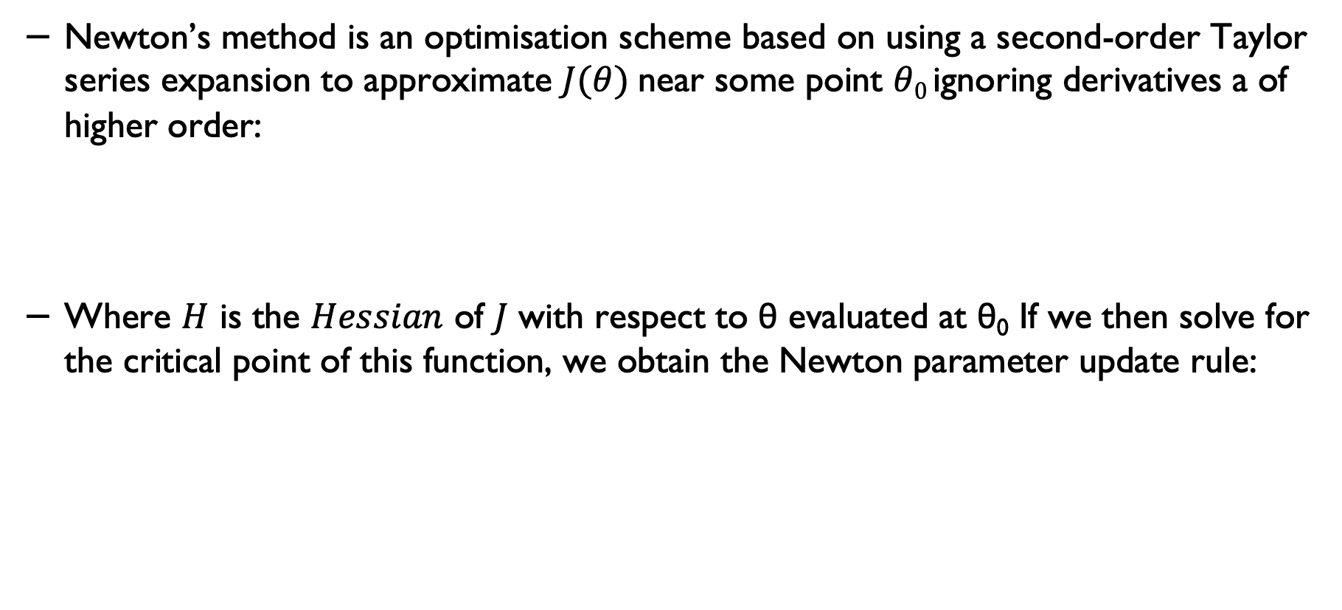
Newton’s method
Newton’s method is an optimisation scheme based on using a second-order Taylor series expansion to approximate $J(θ)$ near some point $θ0$ignoring derivatives a of higher order:
Where $H$ is the $Hessian$ of $J$ with respect to θ evaluated at θ₀ If we then solve for the critical point of this function, we obtain the Newton parameter update rule:
Source: Adapted from Goodfellow et al., deep Learning, https://www.deeplearningbook.org/contents/optimization.html
For more information see Chapter 8 of Goodfellow et al.’s book.

Slide 69
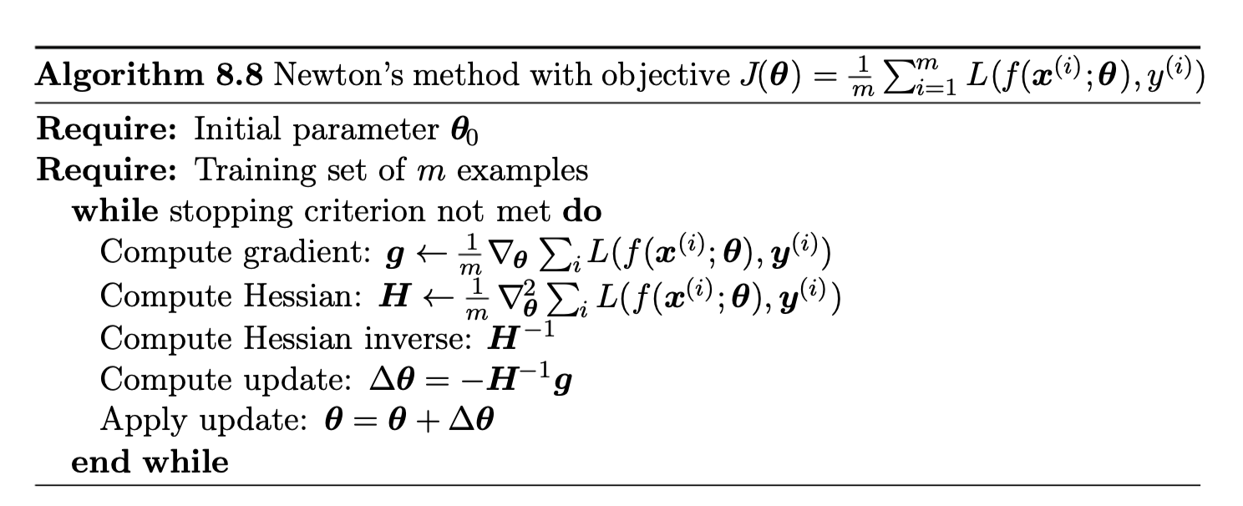
Newton’s method – the algorithm
If the objective function is convex but not quadratic (there are higher-order terms), this update can be iterated, yielding the training algorithm associated with Newton’s method, given in algorithm
Source: Adapted from Goodfellow et al., Deep Learning, MIT Press, https://www.deeplearningbook.org/contents/optimization.html

Slide 70

The $Hessian$Matrix ($H$)
For more information on the Hessian matrix and how to derive it, see:
https://www.khanacademy.org/math/multivariable-calculus/applications-of-multivariable-derivatives/quadratic-approximations/a/the-hessian

